Slide 1
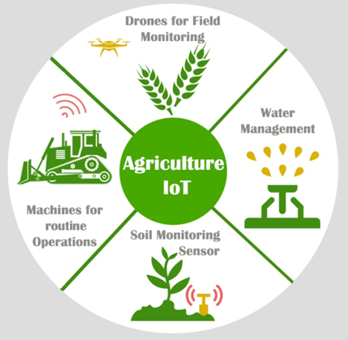
SMART AGRICULTURE SYSTEM
By-
Akash Bhorkade

Slide 2
ABSTRACT:
Smart Agriculture System based on IoT can monitor soil moisture and climatic conditions to grow and yield a good crop.
The farmer can also get the real time weather forecasting data by using external platforms like Open Weather API.
Farmer is provided a mobile app using which he can monitor the temperature, humidity and soil moisture parameters along with weather forecasting details.
Based on all the parameters he can water his crop by controlling the motors using the mobile application.

Slide 3
SPECIFICATION:
There are Five main unit:
IBM Watson IoT cloud platform
IoT Simulator
Node-Red
Node-Red UI Dashboard
Sensors:
Temperature Sensor
Humidity Sensor
Pressure Sensor

Slide 4
OUTCOME:
Even if the farmer is not present near his crop he can water his crop by controlling the motors using the mobile application from anywhere.
The yield appeared beneath signifies the temperature ,soil dampness state and humidity present in the soil.
The next outcome is the yield as of Android purpose that is produced in the cell phone. It decides the temperature, stickiness and dampness.

Slide 5
CONCLUSION:
The points of interest like water sparing and work sparing are started utilizing sensors that work consequently as they are modified.
This idea of modernization of farming is straightforward, reasonable and operable.
As relying upon these parameter esteems rancher can without much of a stretch choose which fungicides and pesticides are utilized for enhancing crop creation

Slide 6
THANK YOU!

